Slide 1
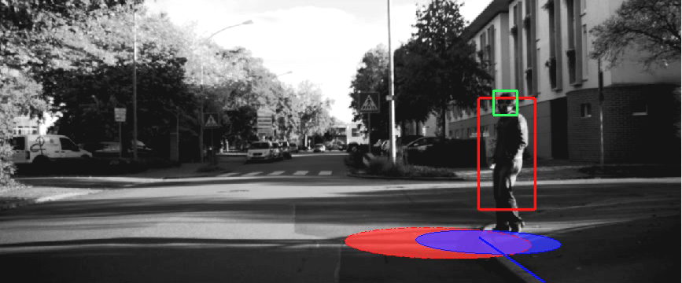


Julian Kooij Intelligent Vehicles GROUP TU Delft
Bayesian inference to learn and predict road user behaviours
January 29, 2019
AMLD 2019, Lausanne

Slide 2




About me
April 2016-Now Assistant Professor @ Intelligent Vehicles group
2014-2016 Post-Doc @ Computer Vision Lab, TU Delft
2014 Internship @ Daimler R&D, Ulm Germany
2010-2014 PhD @ University of Amsterdam

Slide 3
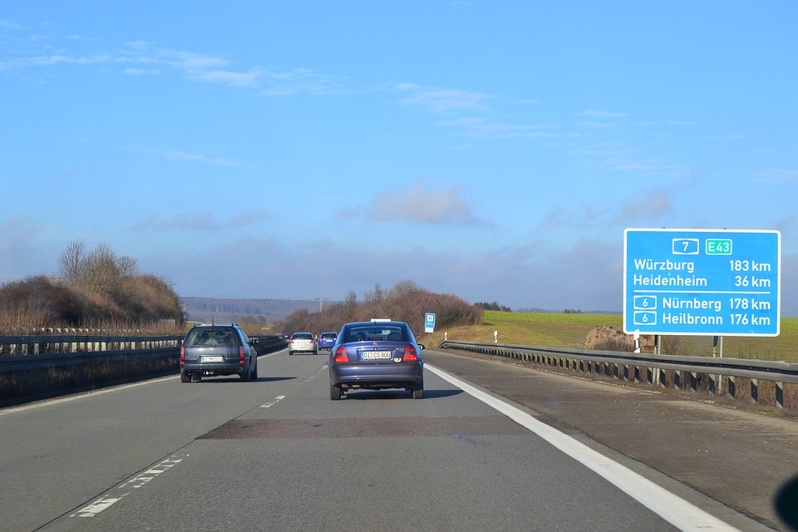
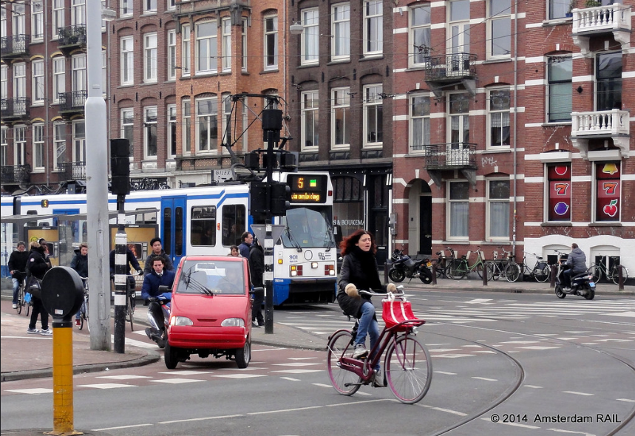
Focus on complex unstructured environments
Interaction with Vulnerable Road Users (VRUs), e.g. pedestrians, cyclists, mopeds
Many occlusions, little reaction time
VRUs can rapidly change motion, direction

Slide 4
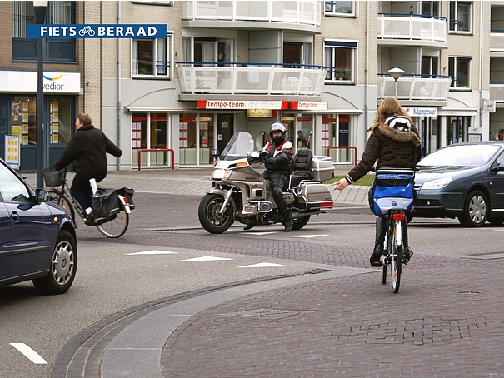
“Understanding” complex situations
Anticipation is crucial for safe, efficient and comfortable driving
Goal: make good predictions about future
Observations are ambiguous
Future (behavior) is inherently uncertain
Decisions should be explainable to same degree

Slide 5
Finding context for dynamics
Given some VRU track data, can we (1) learn a number of switching dynamics, and
(2) the spatial regions where they occur?

Slide 6

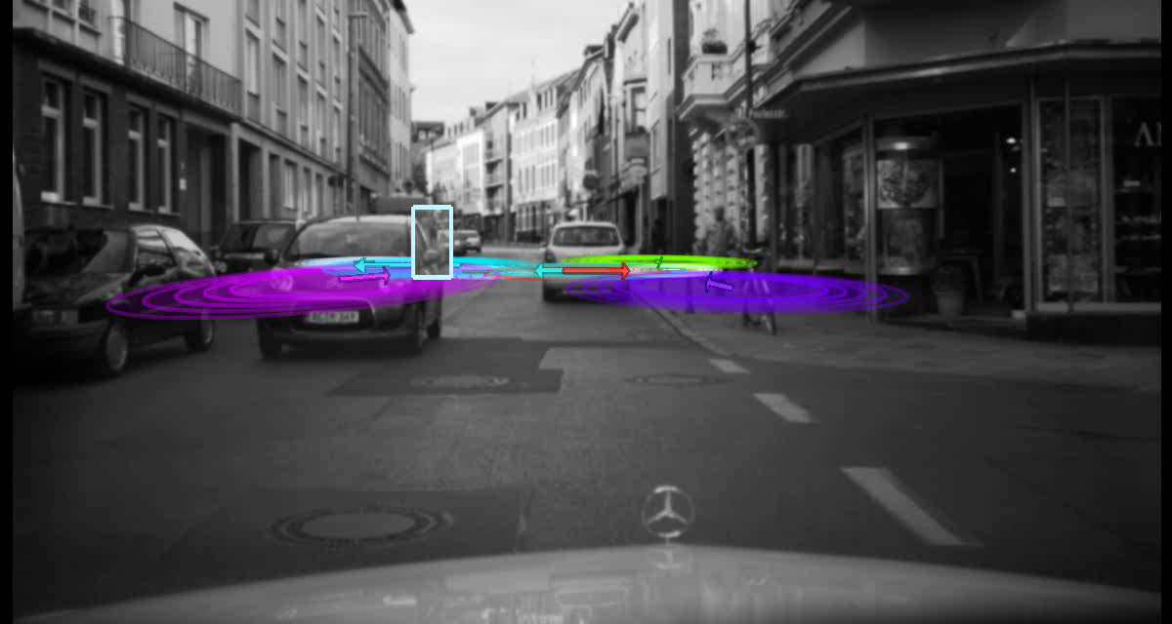
Where a pedestrian is informs what he/she probably will do

Slide 7
Including context into predictions

Slide 8
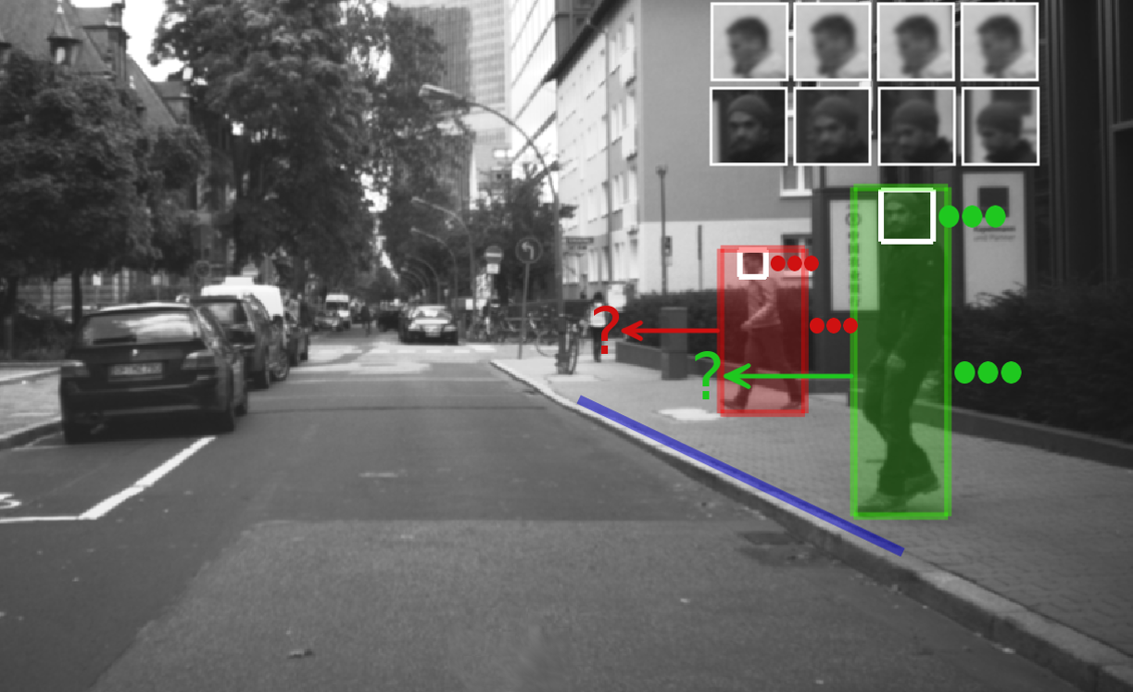
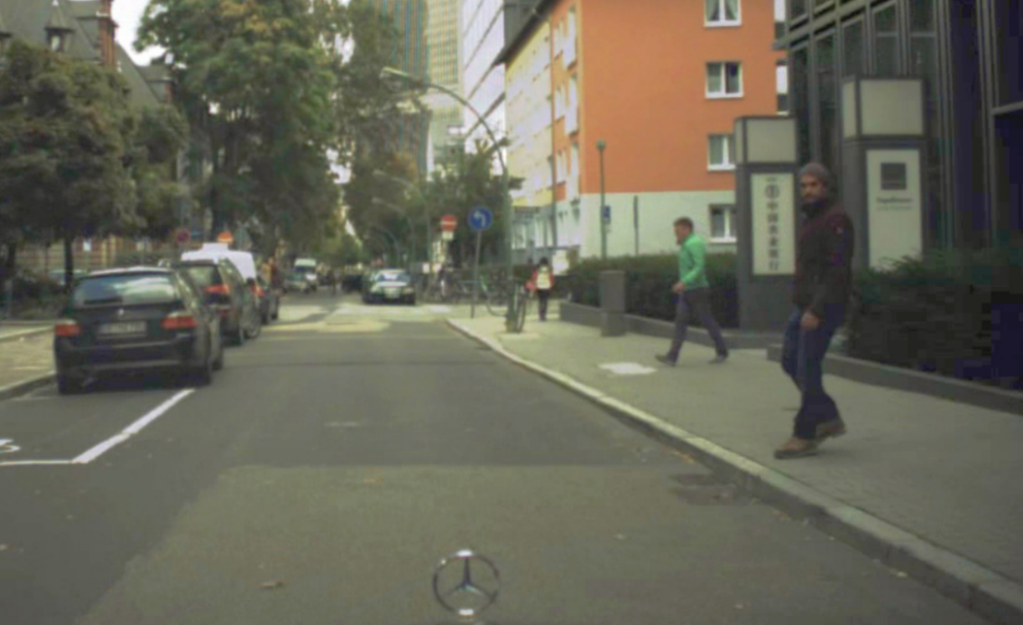
Will these pedestrians cross or stop? Why?
Where pedestian will be in moment? Determine this at 15 frames per second ...
Every second counts!

Slide 9
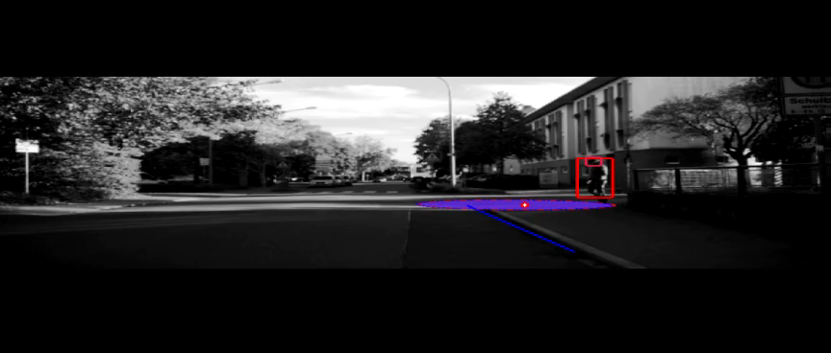

no context (red ellipse) with context (blue ellipse)
J.F.P. Kooij, F. Flohr, E.A.I. Pool, D.M. Gavrila, Context-based VRU Path Prediction, IJCV 2018

Slide 10
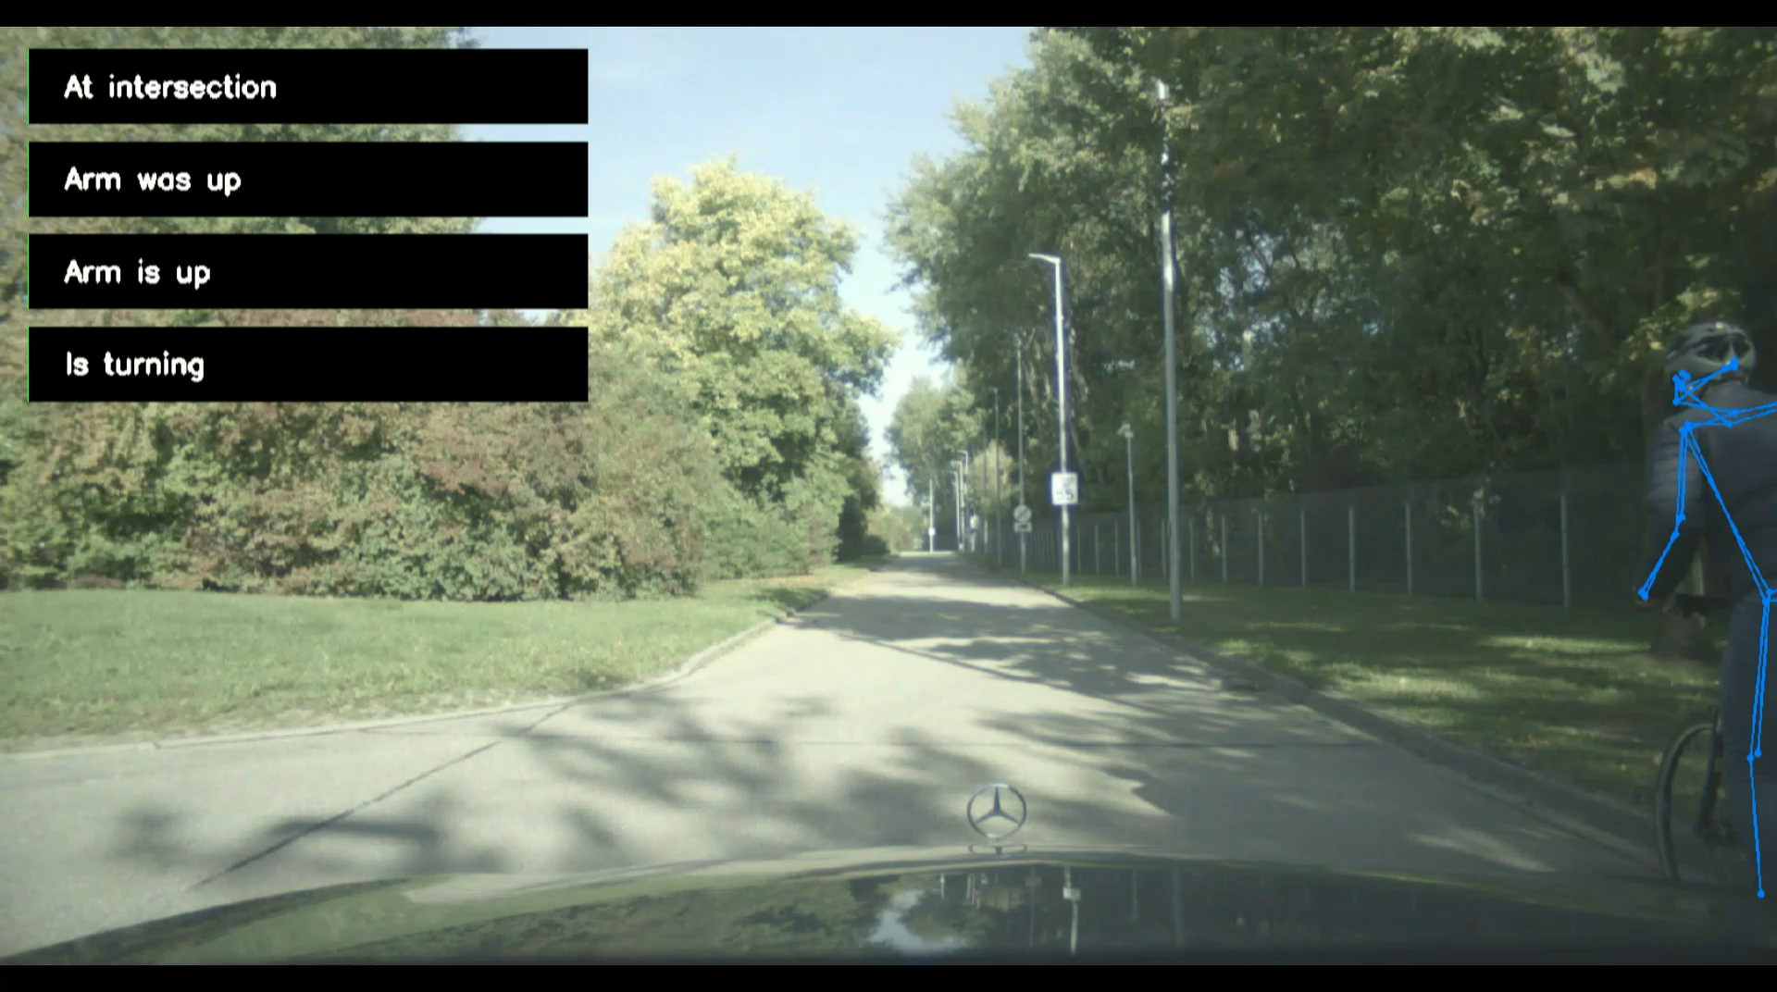
J.F.P. Kooij, F. Flohr, E.A.I. Pool, D.M. Gavrila, Context-based VRU Path Prediction, IJCV 2018

